Slide 1
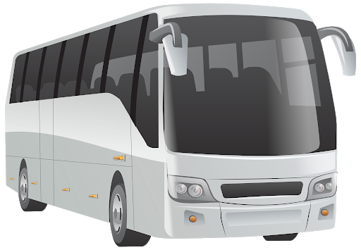

A Mini Project On
“BUS RESERVATION SYSTEM”
PRESENTED BY:
YASH CHATURVEDI (1903480100128)

Slide 2
ABSTRACT
This system is based on a concept to reserve bus tickets. From this system, the user can view bus list, book tickets, cancel bookings and check bus status board.
While booking tickets, the user has to enter bus number then the system displays total bus seat numbers with passengers name and the user has to enter the number of tickets, seat number, and name of the person.
Here, cancel booking also features refunding.
Login system is also available in this system to make it more secure. There’s no chance of data misuse or loss & it’s not time-consuming.
The whole project is developed in ‘C’ Programming language, different variables and strings have been used for the development of this project. It’s easy to operate and understand by users.

Slide 3
FLOW OF SYSTEM
BUS RESERVATION SYSTEM
BUS LIST
RESERVATION
CANCELLATION
STATUS

Slide 4
CONCEPTS UTILIZED
Files
Loops
Functions
Array
Strings

Slide 5
LOGIN
Enter Username and Password
If correct
If Incorrect
You will be directed to main menu….
You will be given two more attempts…
If Incorrect
If correct, within attempts
You will be directed to main menu….
You will be exited from the application….

Slide 6
IF LOGIN WAS SUCCESSFUL…

Slide 7
MAIN MENU
1.
View Bus List
2.
Book Tickets
Enter your choice
(1,2,3,4,5)
To perform the particular operation.
3.
Cancel Booking
4.
Bus Status Board
5.
Logout

Slide 8
IF CHOICE IS 1….
1.
Cardiff Express
2.
Belfast Express
This is the list of buses available in TRAVELPRO Bus agency , for reservation….
3.
Derby Express
4.
Chester Express
5.
Newport Express

Slide 9
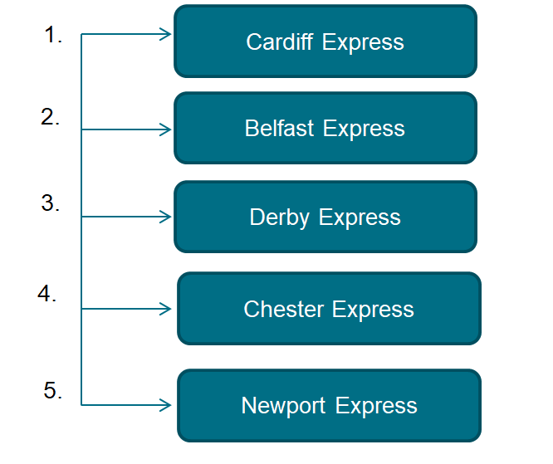
IF CHOICE IS 2….
Numbers written in front are “Bus number”
For reservation user will have to enter bus number of his choice……

Slide 10
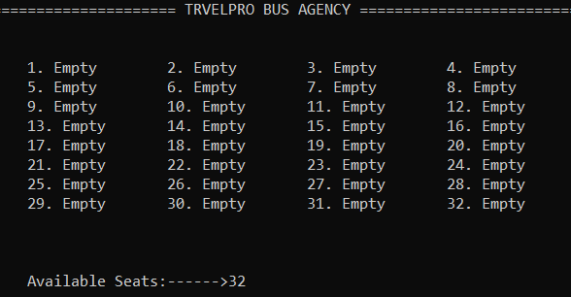
User will now be directed to a new screen
Vacancy status of the bus number entered will be visible→ “Available Seats in Bus”
Now user will have to enter “Number of Tickets”
As per Number of Tickets
Seat Number
User will have to enter details for ticket reservation….
Passenger Name
At last total fare will be shown to the user.

Slide 11
IF CHOICE IS 3….
For cancellation, user will have to enter bus number of his choice……
User will now be directed to a new screen
Seat Number along with its status will be available on the screen.
Enter Seat Number for cancellation…
After cancellation Rs.200 will be refunded

Slide 12
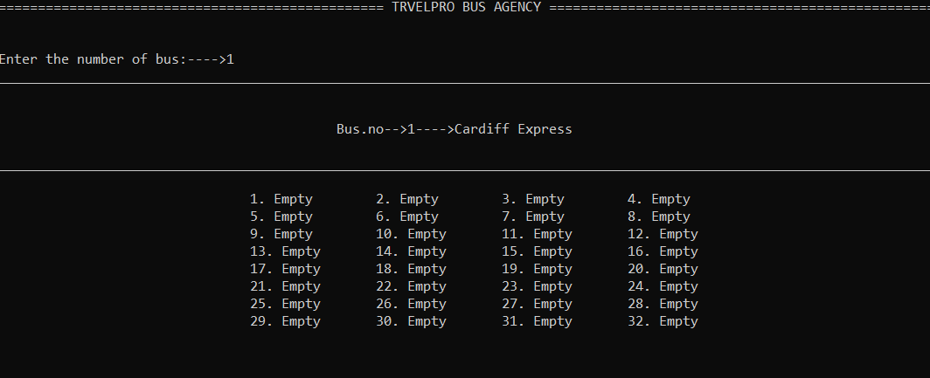
IF CHOICE IS 4….
User will now be directed to a new screen
User will have to enter the bus number

Slide 13
IF CHOICE IS 5….
User is Successfully logged out of the application…..
This message will be shown in the screen after successful logout.
You have successfully logged out of TRAVELPRO.
Thank you for using TRAVELPRO.

Slide 14
CONCLUSION
This was an effort to develop a simple “Bus Reservation System” using which the user can view bus list, book tickets, cancel bookings and check bus status board.
I do hope you find this project useful as well as interesting.

Slide 15

REFERENCES
projectnotes.org
blog.eduonix.com
codewithc.com
P. S. Deshpandey, “C and Data structure”, Wiley Dreamtech Publication
Kanetkar Yashavant P.,”Let Us C”, BPB Publications

Slide 16
THANKS!
Any questions?

